Slide 1
Why polymer theory is beautiful (and why you should care)
Takashi Yokokura
CBE Student Colloquium
04/27/2023

Slide 2
What is beauty (in physics)?
Before today:
Blue butterfly <--> microscopic patterns
CRISPR, radiation, quantum
Traditional beauty and its underlying mechanisms
Civilizational triumphs in fundamental breakthroughs
After today:
Gauss’s Law, Navier-Stokes, Poisson-Boltzmann
Better understanding of the world around us
Systematic approach to solving engineering problems
Abstracting complex phenomena into mathematical models

Slide 3
The (beautiful) math of polymers
1D Gaussian chain
Total possibilities (counting)
Probability
Sterling’s approximation
3D probability
3 independent random walks
Free energy
Boltzmann equation
Probability = f(microstates)
Helmholtz free E
Extension: Hooke’s law
If ends are fixed, polymer is like a spring with entropic spring constant k = 3kT/Nb^2
A highly simplified model can still provide understanding for a complex system. But is it enough to translate to the real world?

Slide 4


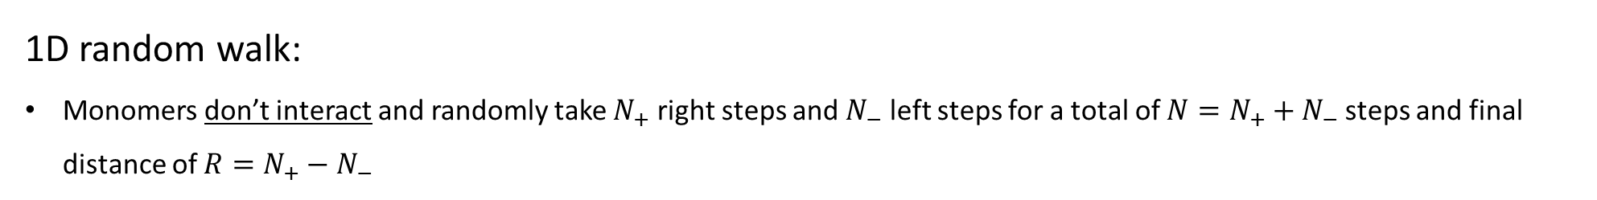

The (beautiful?) math of polymers
1D random walk:
Monomers don’t interact and randomly take $N_{+}$ right steps and $N_{−}$ left steps for a total of $N=N_{+}+N_{−}$ steps and final distance of $R=N_{+}−N_{−}$
2
5
6
1
0
3
4
7
$$R= 5 −2=3$$
Total number of trajectories (possible polymers) for a given $N$ and $R$:

Slide 5
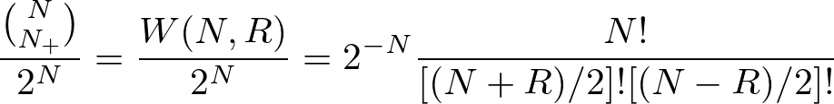
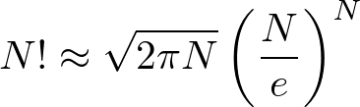
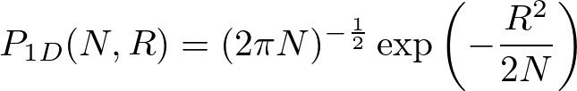
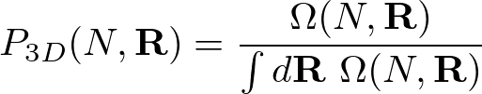

The (beautiful?) math of polymers
Probability
Total number of trajectories (possible polymers) for a given $N$ and $R$:
Algebra
Stirling’s formula:
Only non-zero $W(N,R)$’s (Divide by 2)
Entropy

Slide 6

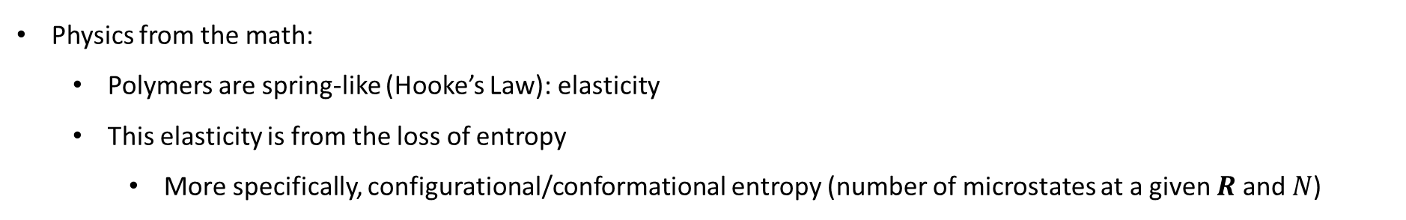
The (beautiful?) math of polymers
Entropy
Free Energy (Helmholtz)
(Monomers non-interacting)
Physics from the math:
Polymers are spring-like (Hooke’s Law): elasticity
This elasticity is from the loss of entropy
More specifically, configurational/conformational entropy (number of microstates at a given $R$ and $N$)
R
R
R
R
R
R
Elastic penalty

Slide 7
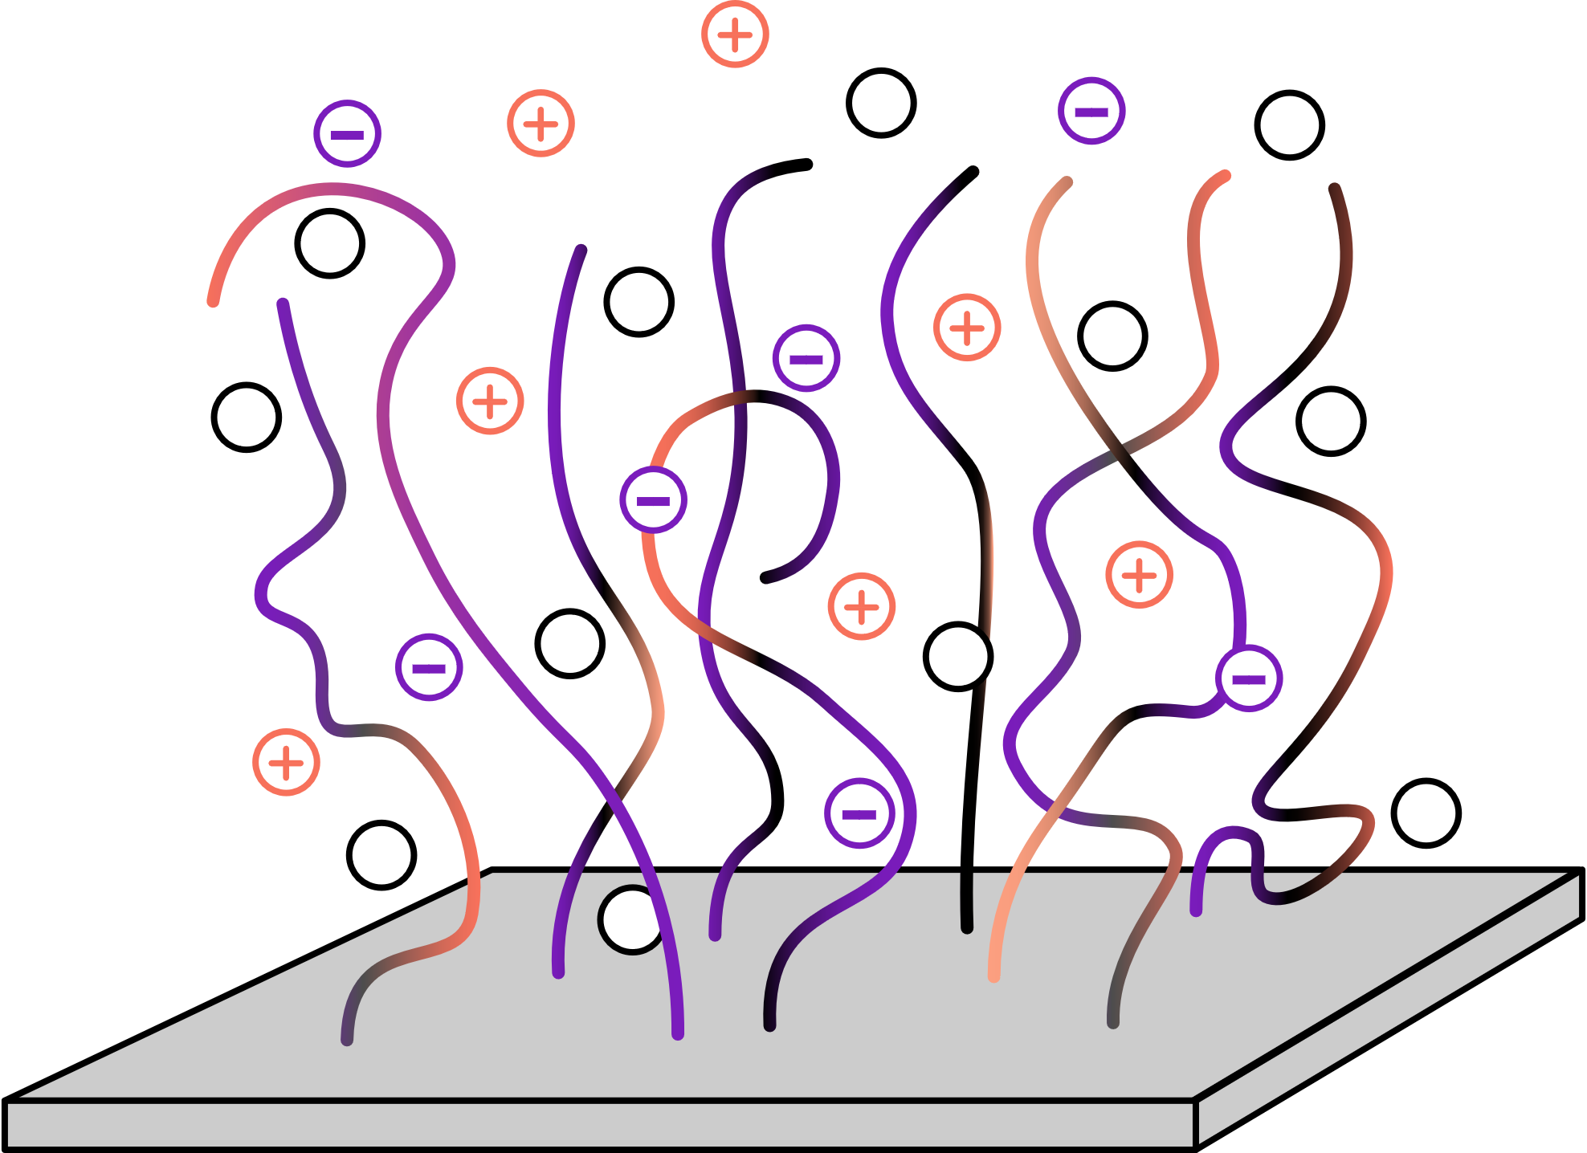
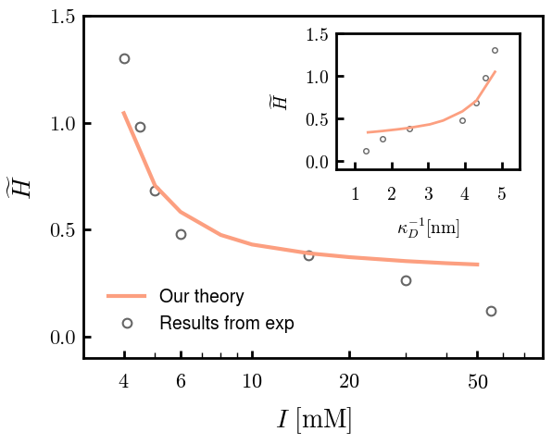
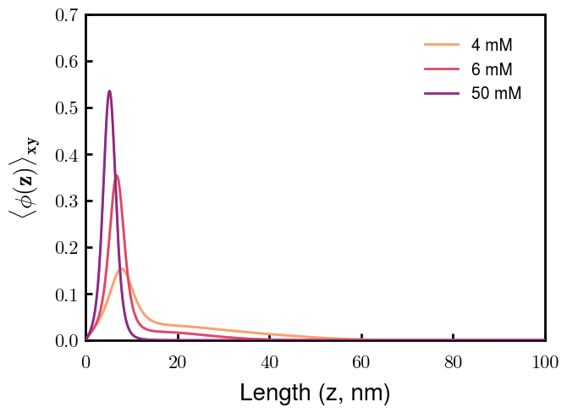
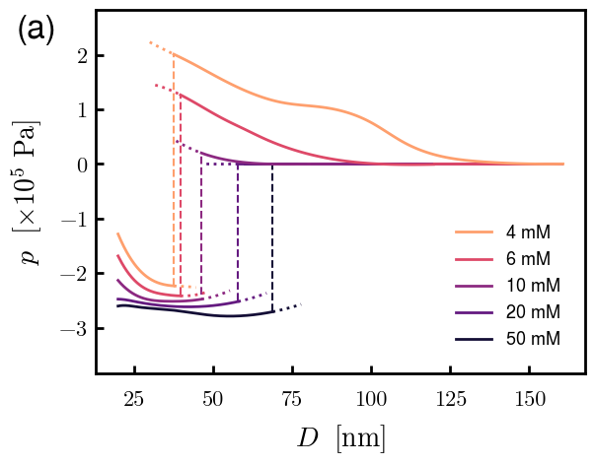

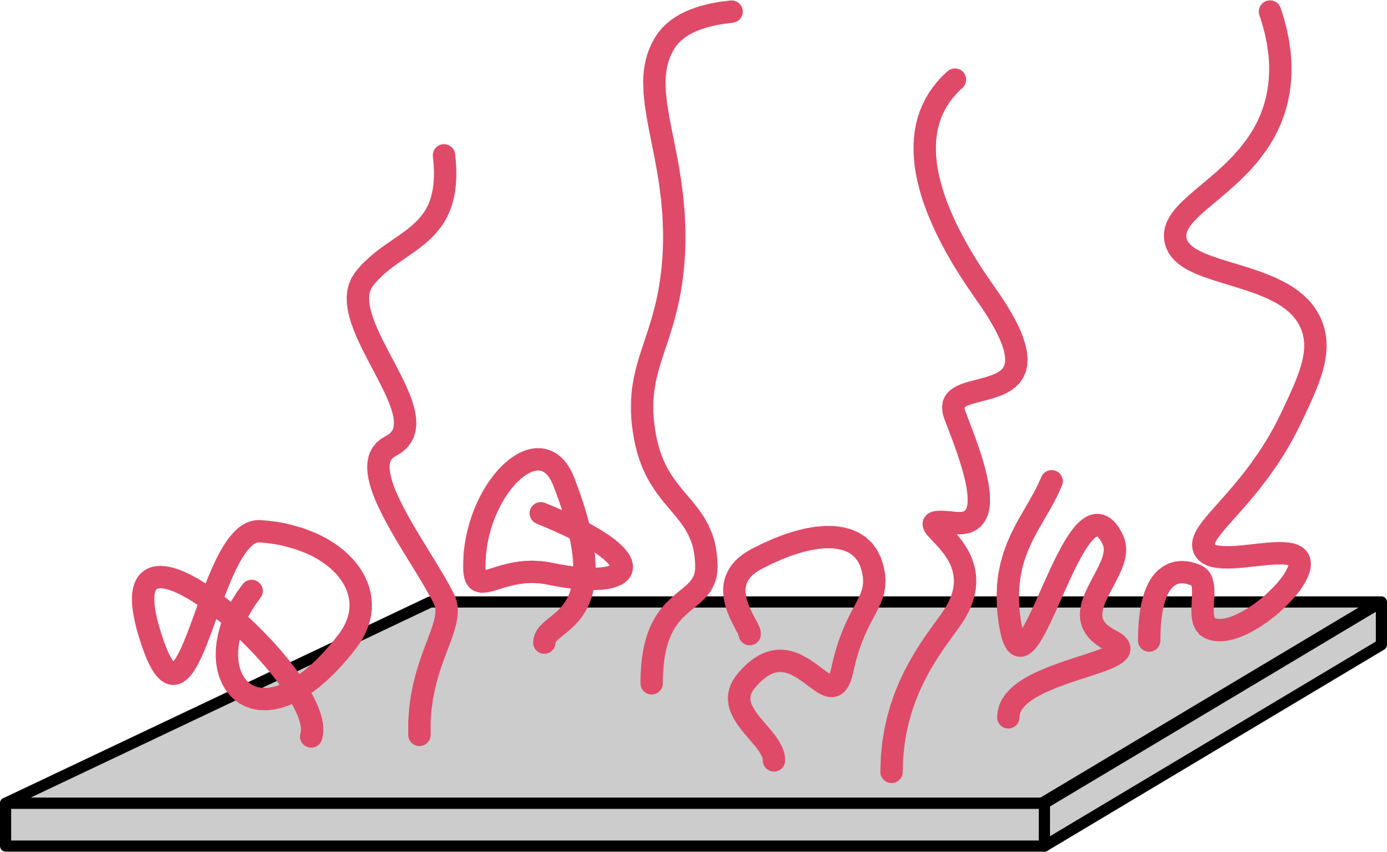
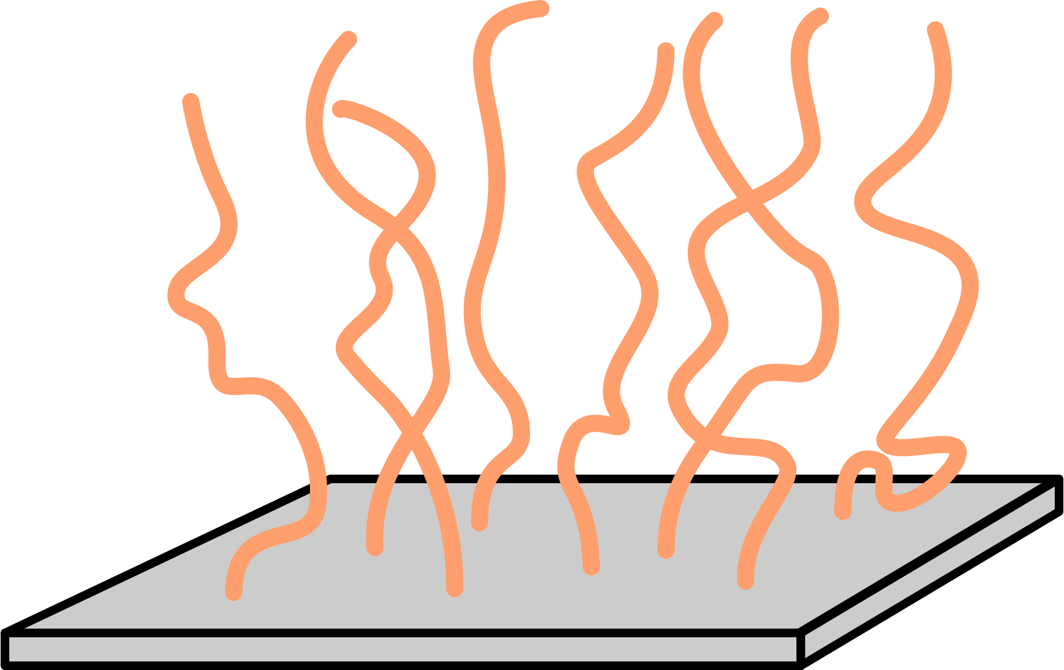
With a little more sophistication, theory can be a powerful, relevant tool
Consider Gaussian chain attached to substrate (brush), polymer-solvent interactions (FH), and polymer-ion electrostatic interactions
Experimental comparison
Polymer organization
Spectra predictions
I
More importantly,

Slide 8
Other (beautiful?) applications of our theory
Vesicle fission by topology
Aggregation
Something about NLH?

Slide 9
Thank you!

Slide 10
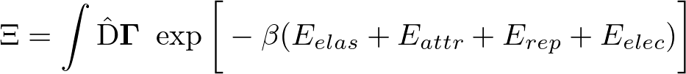
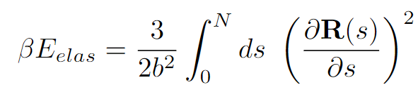
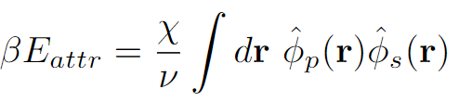
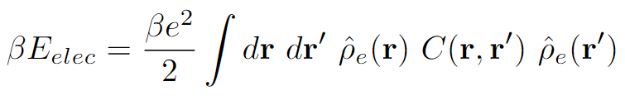

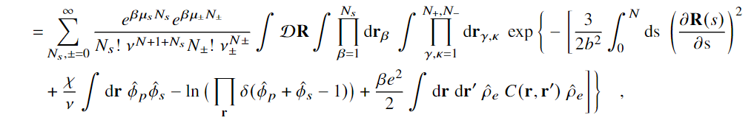
Partition Function Formulation
+
s
s
-
Elastic entropy following Gaussian statistics
+
-
+
s
s
Flory-Huggins short-range interactions
s
-
+
+
+
+
+
+
+
+
+
s
-
s
+
Electrostatic correlations
-
+
s
s
-
Local incompressibility
s
+
+
s

Slide 11

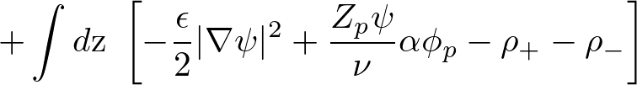

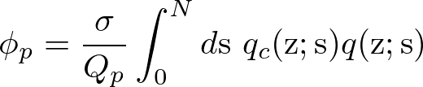
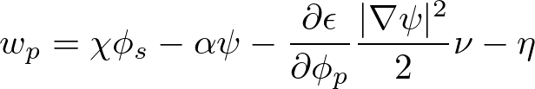
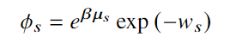


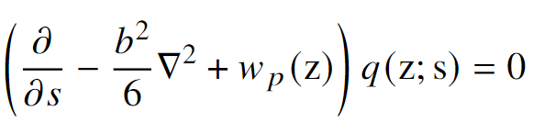
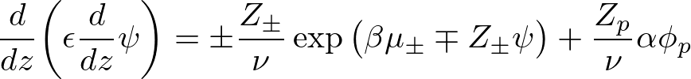



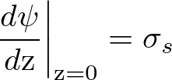

Free Energy and SCF Equations
Free Energy (ensemble average across surface)
Functional Minimization
Polymer Density:
Polymer-controlling Field:
Solvent Density:
Solvent-controlling Field:
Incompressibility:
Monomer Probability:
Electrostatic Potential:

